Slide 1

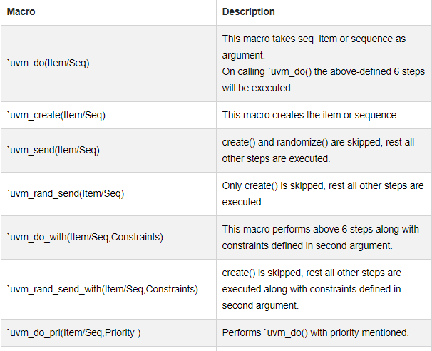
UVM sequence macros
Notes:
These macros are used to start sequences and sequence items on the default sequencer (m_sequencer).

Slide 2
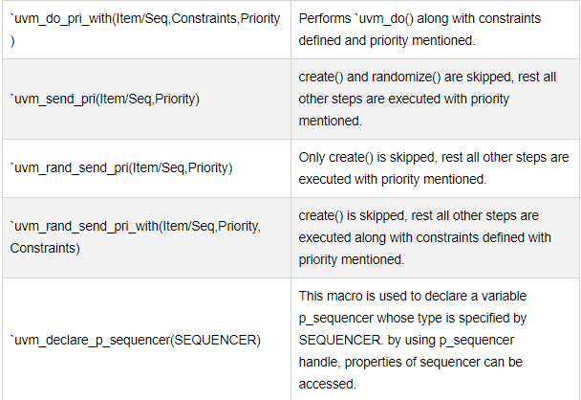
UVM sequence macros

Slide 3
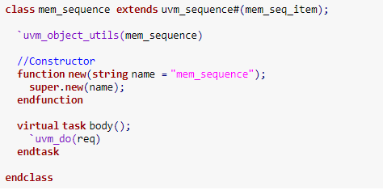
Using `uvm_do

Slide 4
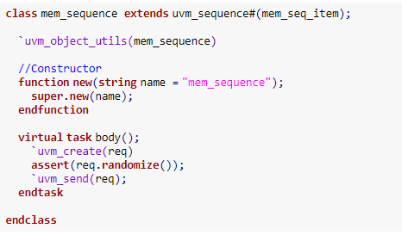
Using `uvm_create() and `uvm_send()

Slide 5
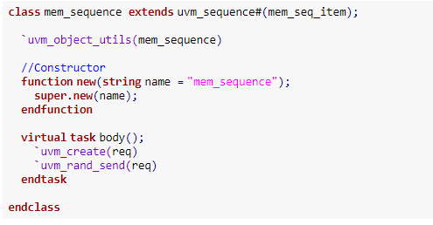
Using `uvm_rand_send()

Slide 6
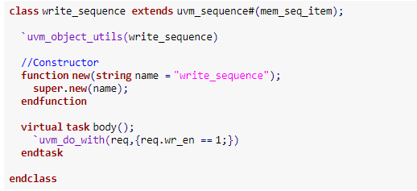
Using `uvm_do_with

Slide 7
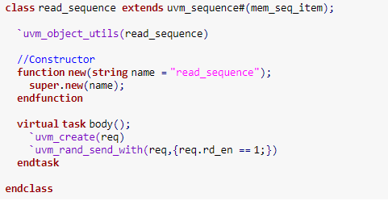
Using `uvm_rand_send_with()

Slide 8
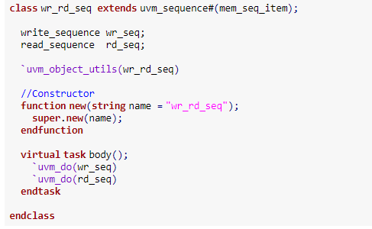
Calling sequences inside the sequence

Slide 9
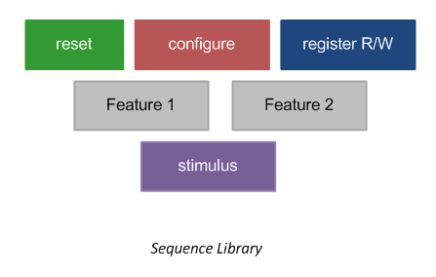
Creating and using a sequence
What is a sequence item?
Some options for sequences are:
Use existing sequences to drive stimulus to the DUT individually
Combine existing sequences to create new ones
For eg: Reset → Register R/W → FSM State Change
Pull random sequences from sequence library and execute them on DUT
Notes:
You may have a sequence that performs register read/writes to all registers within the design, a sequence to perform reset, or another one to apply some stimulus to the DUT. This gives a number of different sequences that perform different tasks to verify different aspects of the design.
NOTE: A sequence item refers to a packet of data, while a sequence is just a container for an arrangement of items/sub-sequences.
For combine existing sequences, for example, you can perform the reset sequence followed by register read/writes followed by FSM state change sequence.

Slide 10
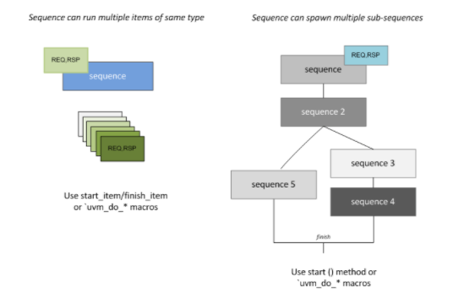
Creating and using a sequence
Sequences can do operations on sequence items, or kick-off new sub-sequences.
Execute using the start() method of a sequence or `uvm_do macros
Execute sequence items via start_item/finish_item or `uvm_do macros
Notes:
`uvm_do macros will identify if the argument is a sequence or sequence_item and will call start() or start_item accordingly.

Slide 11
Creating and using a sequence
Derive from uvm_sequence base class with a specified data object type.
Register the sequence with the factory using `uvm_object utils.
Set the default sequencer that should execute this sequence.
Code the main stimulus inside the body() task.

Slide 12
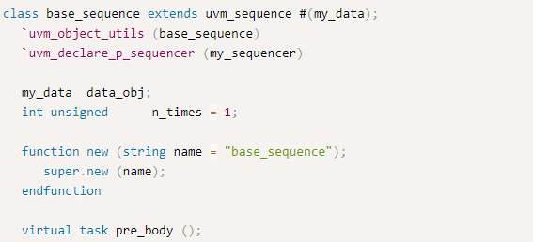
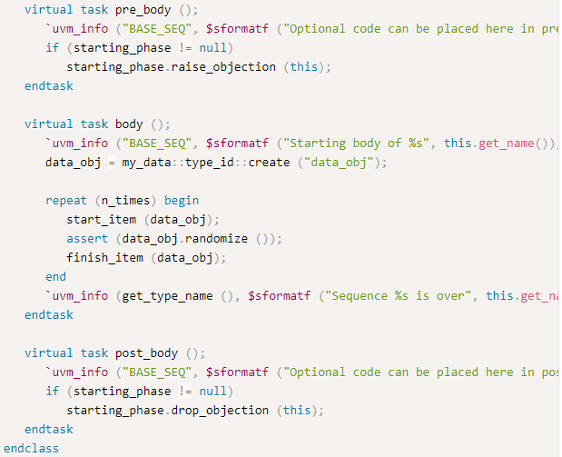
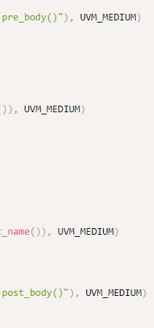
Notes:
Note the following from the example above:
1. base_sequence has been derived from uvm_sequence with a data object type my_data
2. This sequence is specified to execute with my_sequencer using the macro `uvm_declare_p_sequencer
3. Main task body() contains the code to drive the stimulus to the driver.
4. There are two additional tasks pre_body() and post_body() that can be included (but optional) to perform some task before and after executing the body()
5. When a sequence has started, always raise a flag/objection to let the testbench know that it's still active. This flag/objection should be lowered when the sequence finishes so that testbench can finish the simulation and exit gracefully. If the flag is not raised, then there are chances that some other component in the testbench call a simulation exit and the sequence will be exited abruptly. You may also place it in the body() task.
6. The data object will be randomized and sent to the driver via start_item and finish_item

Slide 13
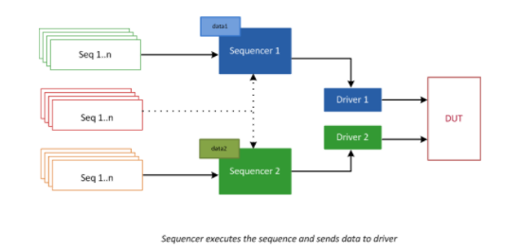
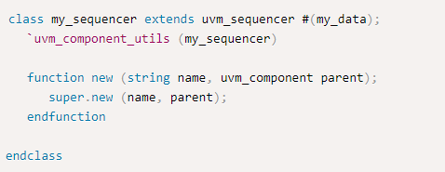
Creating and using a sequence
Notes:
The sequencer to execute this sequence needs to be created.

Slide 14
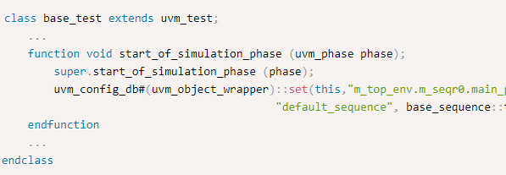
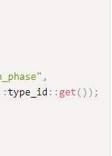
Creating and using a sequence
uvm_config_db is used to configure UVM components dynamically at run time
Notes:
The default sequence needs to be set to the base sequence.
this line of code is configuring the UVM testbench to use base_sequence as the default sequence for the sequencer m_seqr0 during the main_phase of simulation
uvm_config_db is used to configure UVM components dynamically at run time.
uvm_config_db#(uvm_object_wrapper): This specifies that the configuration database is being used to set a value related to an object that is derived from uvm_object, as indicated by the uvm_object_wrapper. The wrapper is used because it allows for polymorphism, enabling any uvm_sequence (since sequences are derived from uvm_object) to be specified dynamically at runtime.
::set: This is a static method of uvm_config_db

Slide 15
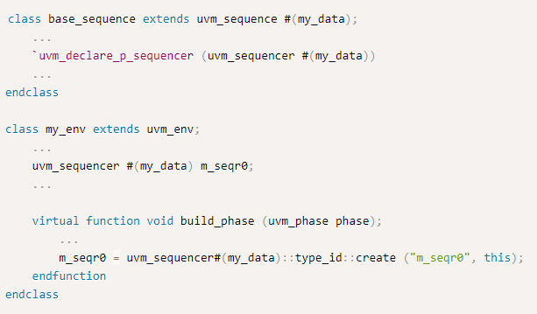
Use uvm_sequencer
Notes:
If you don’t want to create a new sequencer class and instead prefer to use uvm_sequencer, you can do so by substituting the appropriate lines. This will create a sequencer of type uvm_sequencer that can operate on data my_data instead of the user defined custom sequencer.

Slide 16
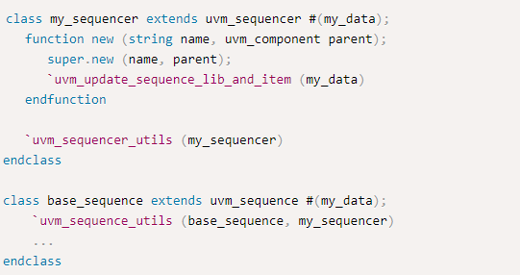
Use uvm_sequence_utils
Notes:
`uvm_sequence_utils is used for the sequence and `uvm_sequencer_utils is used for the sequencer while registering with the factory.
Remember to call the `uvm_update_sequence_lib_and_item macro to update the database.

Slide 17
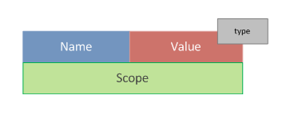
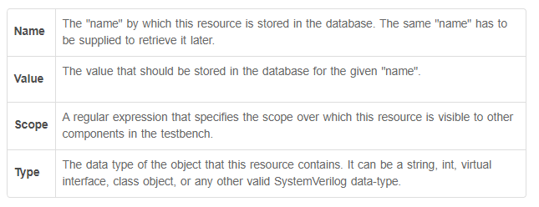
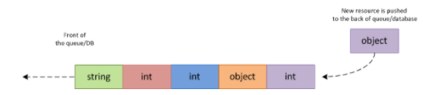
Resource database
RESOURCE:-
a parameterized container
holds arbitrary data
configure components
supply data to sequences
enable sharing of information across testbench parts
Notes:
A resource is a parameterized container that holds arbitrary data. Resources can be used to configure components, supply data to sequences, or enable sharing of information across disparate parts of the testbench. You can put any data type into the resource database, and have another component retrieve it later at some point in simulation, which is a very convenient feature to have.
The global resource DB has both a name table and a type table into which each resource is entered. So, the same resource can be retrieved later by name or type.
Multiple resources with the same name/type are stored in a queue and hence those which were pushed in earlier have more precedence over those placed later.
From the queue shown above, if a request to retrieve an item of type string is made, the queue is traversed from front to back, and the first occurrence of an object of string type will be returned. Now, consider the case where the items 2(red) and 3(blue) in the queue have the same scope, and a get_by_type() method is called for that particular scope. Then, item 2 will be returned since that sits earlier in the queue.
Resources are added into the pool by calling set, and they are retrieved from the pool by get_by_name() or get_by_type()

Slide 18

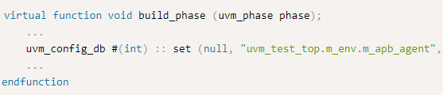
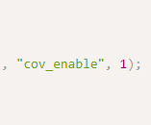
Configuration Database (UVM Config db)
provides access to centralized db, where type specific information can be stored and retrieved
All functions are static and must be called using :: scope operator
uvm_config_db::set – store information in db
can contain scalar objects, class handles, queues, lists, or even virtual interfaces
Notes:
The static function of the class uvm_config_db is used to set a variable in the configuration database.
T is the type of element being configured and can be scalar objects, class handles, queues, lists or even virtual interfaces
cntxt is the hierarchical starting point of where the db entry is accessible.
inst_name is a hierarchical path that limits the accessibility of the database entry.
field_name is the label used as a lookup for the database entry
value is the value to be stored in the database.
In the example given, set() function will set a variable of name cov_enable at the path uvm_test_top.m_env.m_apb_agent with value 1.
Use of set() creates a new or updates an existing configuration setting for field_name in inst_name from cntxt. This setting is made at cntxt with the full scope of the set being (cntxt, “.”, inst_name). If cntxt is null, then the complete scope of getting the information will be provided by inst_name.

Slide 19
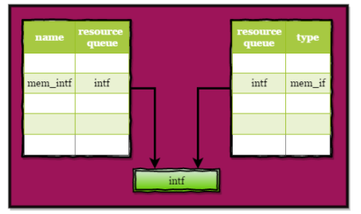
Configuration Database (UVM Config db)
Notes:
This example shows the setting of the interface handle intf, type mem_if, label mem_intf with global scope.
The diagram shows how a resource whose name is mem_intf and type is mem_if is stored in the pool.

Slide 20
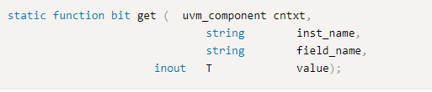
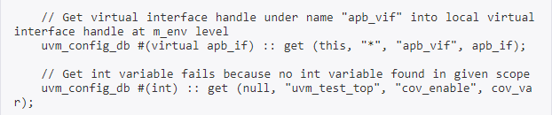
Configuration Database (UVM Config db)
uvm_config_db::get – retrieve information in db
Notes:
This static function is used to get the value of variable given in field_name from the configuration db. value is the variable to which the value is to be retrieved from the db.
The method returns 1 if successful and 0 if there is no such resource of this type in the db.

